Slide 1
New Resource Sharing Workflows in Alma

Slide 2
Agenda
Fulfilling article requests using library owned physical issues
Branch library processing of digital requests
Previous session on ‘Article resource sharing requests in Alma networks’
Recording: Article resource sharing requests in Alma networks YouTube Video
Presentation: Article resource sharing requests in Alma networks accompanying PowerPoint

Slide 3
Fulfilling article requests using library owned physical issues

Slide 4
Fulfilling article requests using library owned physical issues
Resource sharing digitization process is well suited for managing article requesting:
The request form is very descriptive and automatically populated with all of the article’s metadata
The lender can digitize the requested article, or assign a task for a branch library
Can accommodate different practices of physical journal cataloguing
The digitized content can be easily and securely sent to the requester
If the request is not fulfilled by the library then it can be forwarded to other libraries
From the fulfillment staff perspective, the workflow is very similar (if not identical) to the Alma Digitization Request process
Catalog every issue
Catalog one item and use its Description field to describe the coverage
Catalog only a holdings record, with a Summary Holdings Statement

Slide 5
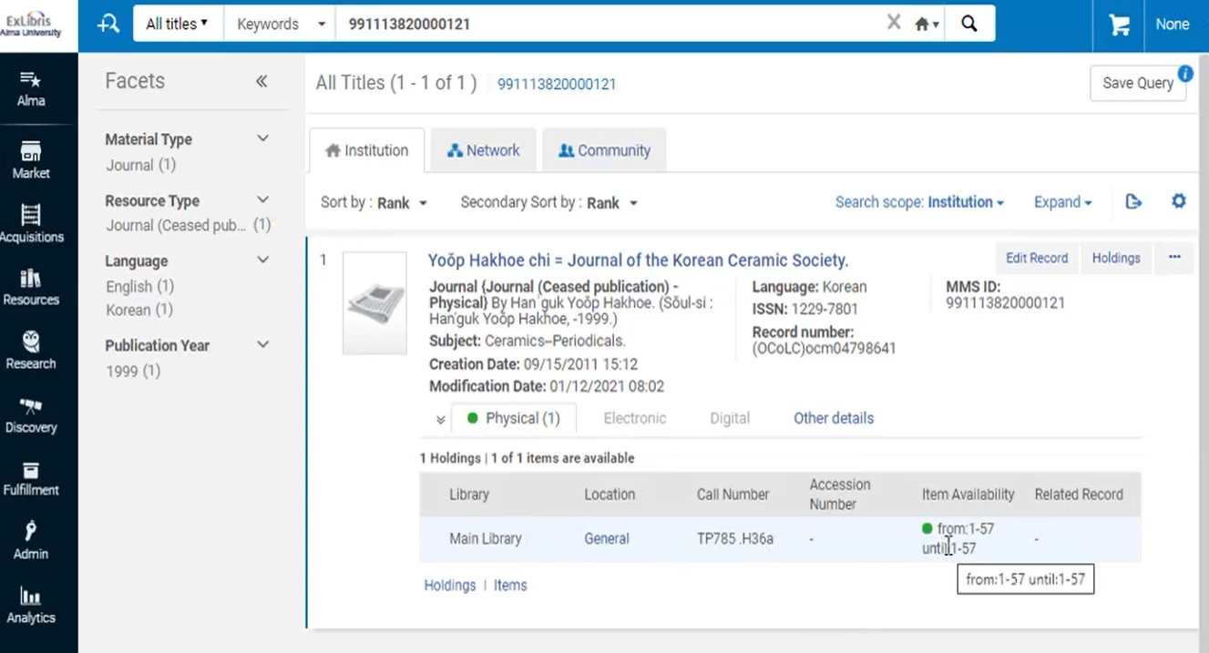
Fulfilling article requests using library owned physical issues
This is physically owned journal
A single item has been catalogued to reflect the 57 volumes held by the library

Slide 6
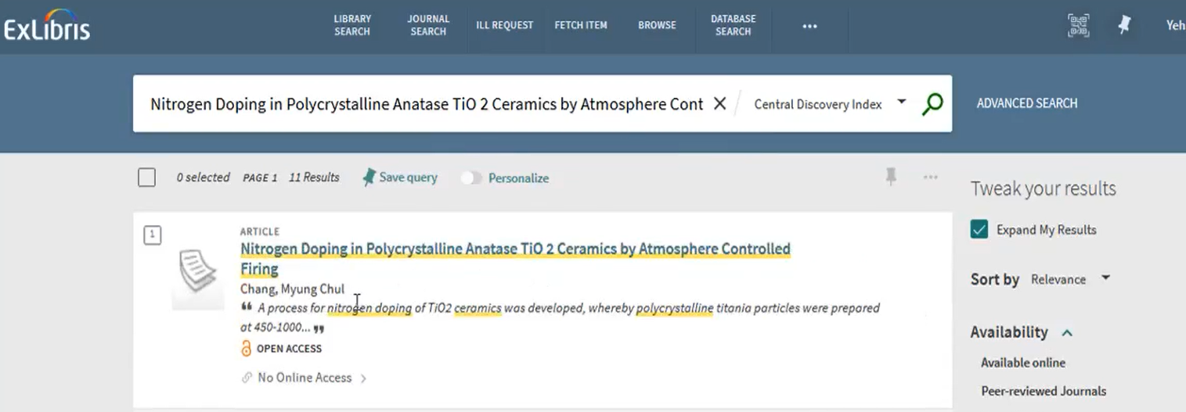
Fulfilling article requests using library owned physical issues

Slide 7
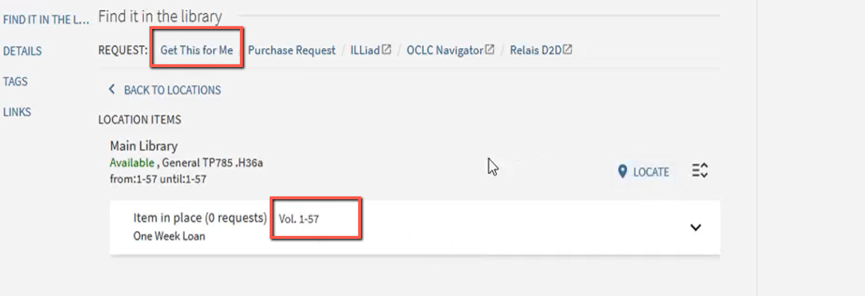
Fulfilling article requests using library owned physical issues
A single ‘Get this for me’ option is actually a resource sharing request

Slide 8
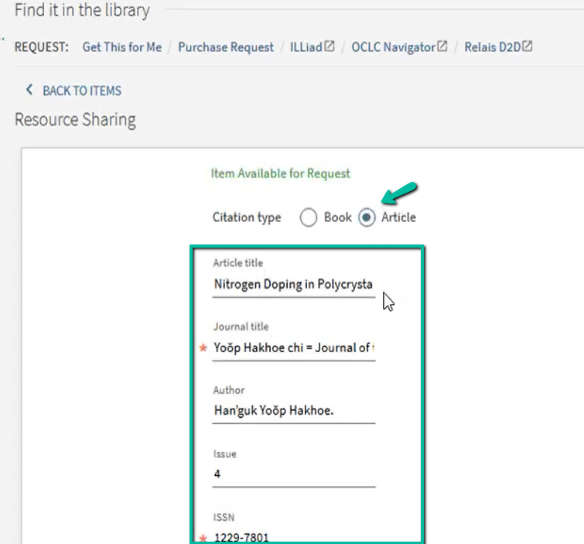
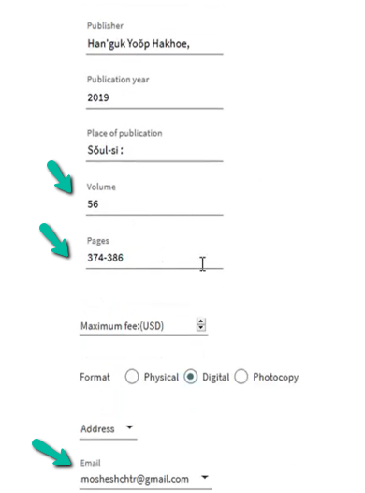
Fulfilling article requests using library owned physical issues

Slide 9
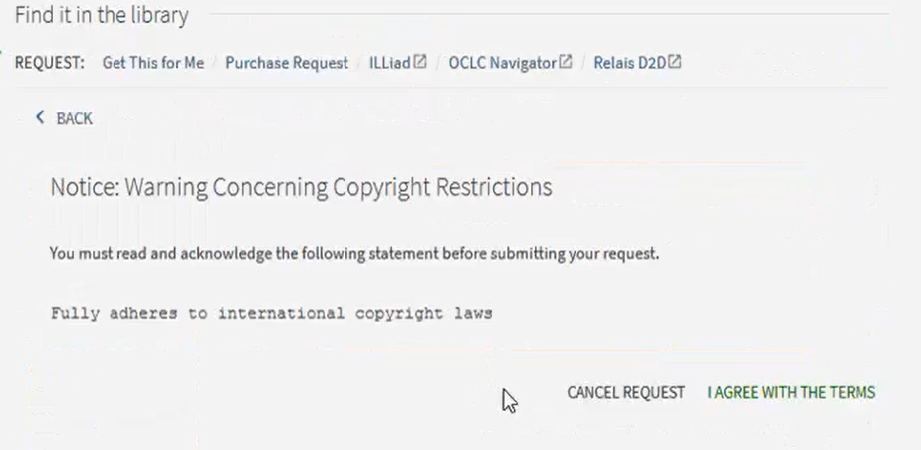
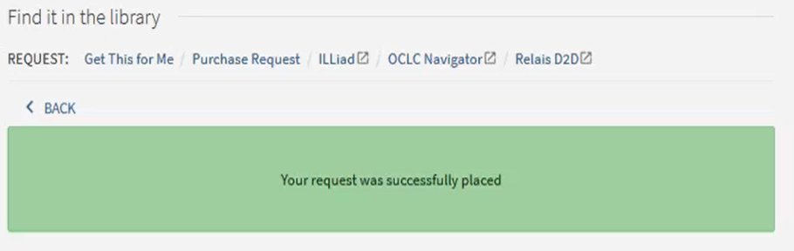
Fulfilling article requests using library owned physical issues

Slide 10
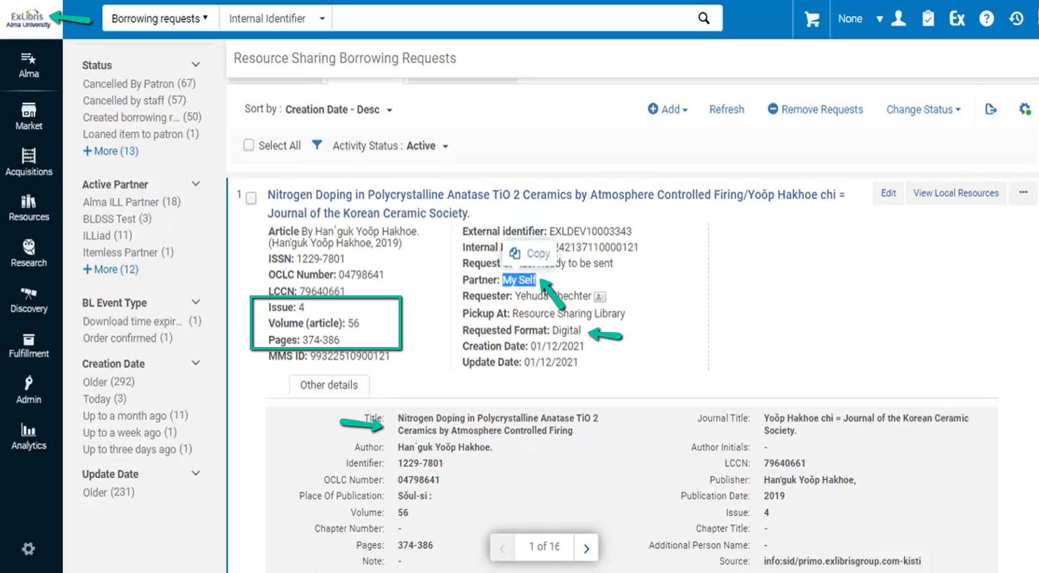
Fulfilling article requests using library owned physical issues

Slide 11
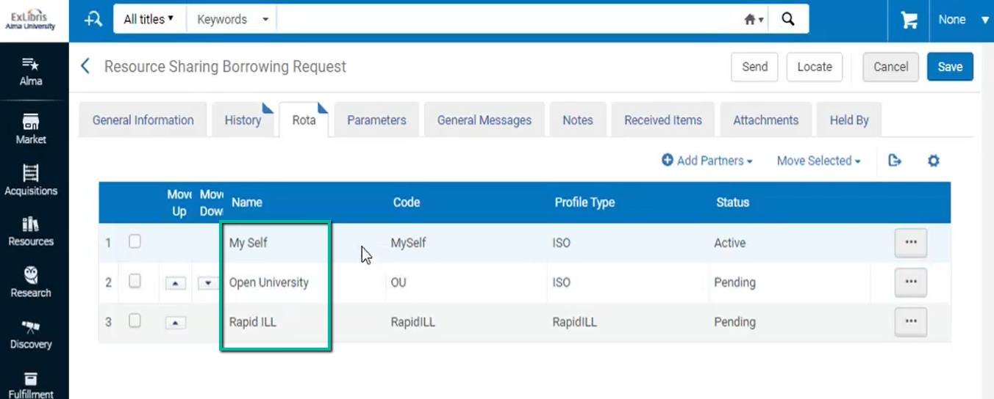
Fulfilling article requests using library owned physical issues
The rota will automatically try to fulfill using my own inventory, then propagate to a consortial lender, and then be sent outside of my network.
A locate process can create a fine-tuned rota of potential consortial lenders

Slide 12
Fulfilling article requests using library owned physical issues
Note : The physical locate process identifies only ownership of the journal. Only electronic coverage is identified on the article level

Slide 13
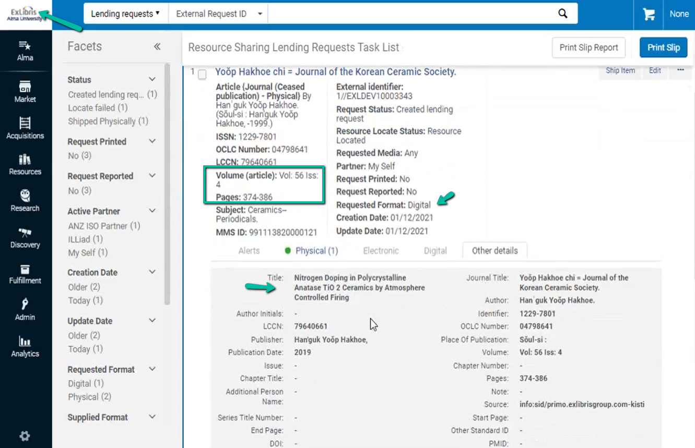
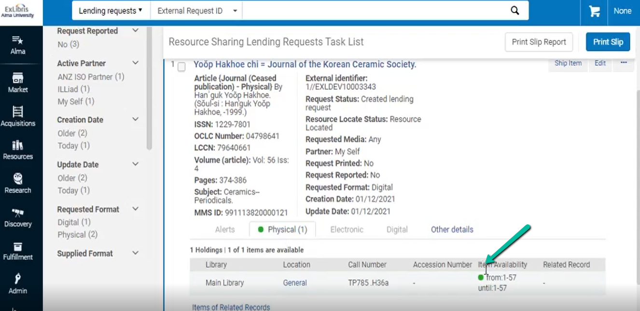
Fulfilling article requests using library owned physical issues

Slide 14
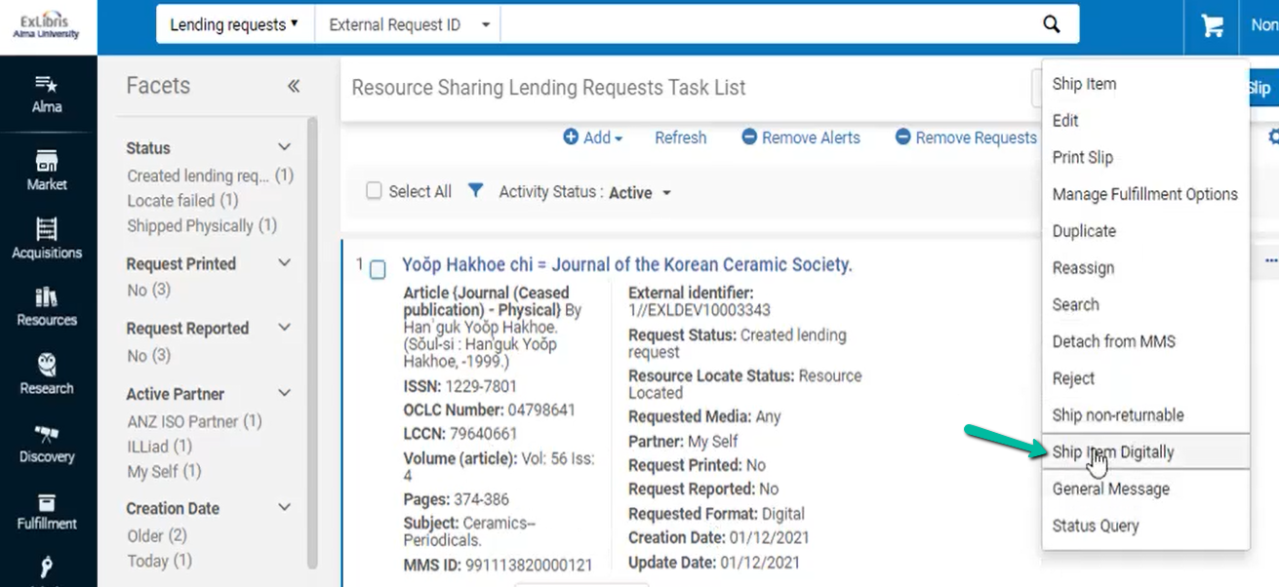
Fulfilling article requests using library owned physical issues
We will take a look at the digitization process in the next couple of slides. For now lets assume a digitized file has been prepared

Slide 15
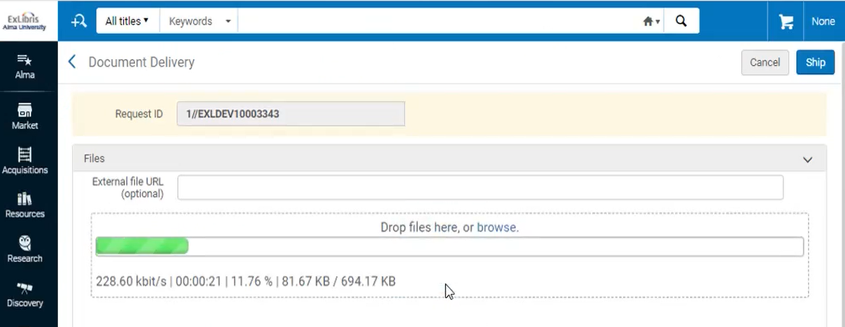
Fulfilling article requests using library owned physical issues
Request is now out of my active task list on both borrower and lender side

Slide 16
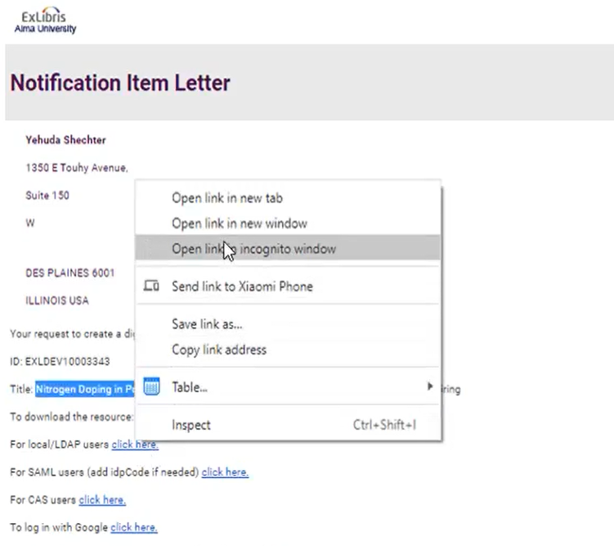
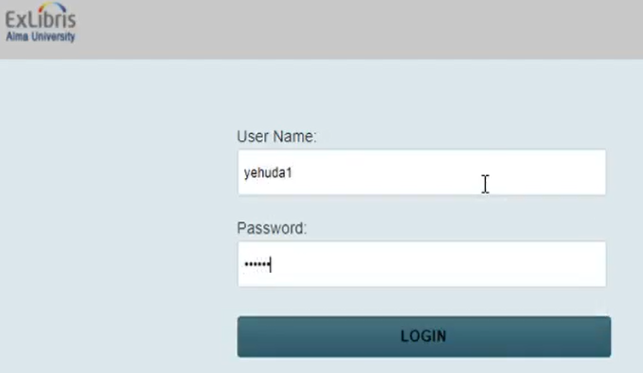
Fulfilling article requests using library owned physical issues
The patron gets the email with the link to the document

Slide 17
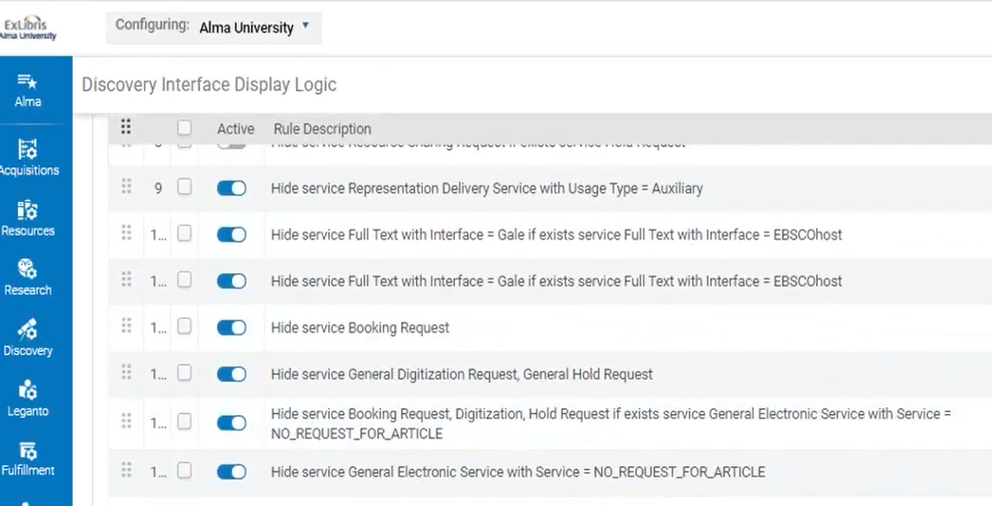
Configuration
The configuration is based on display logic rules
Article requesting will be only as resource sharing requests
There will be no hold request option for articles

Slide 18
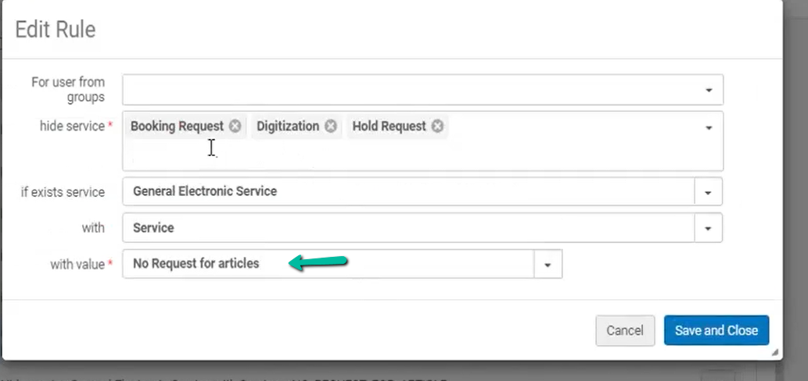
Configuration
This is a General Electronic Service that appears only for articles. This rule is equivalent to saying ‘hide request options for articles’.
We’ll see how the General Electronic Service is set up

Slide 19
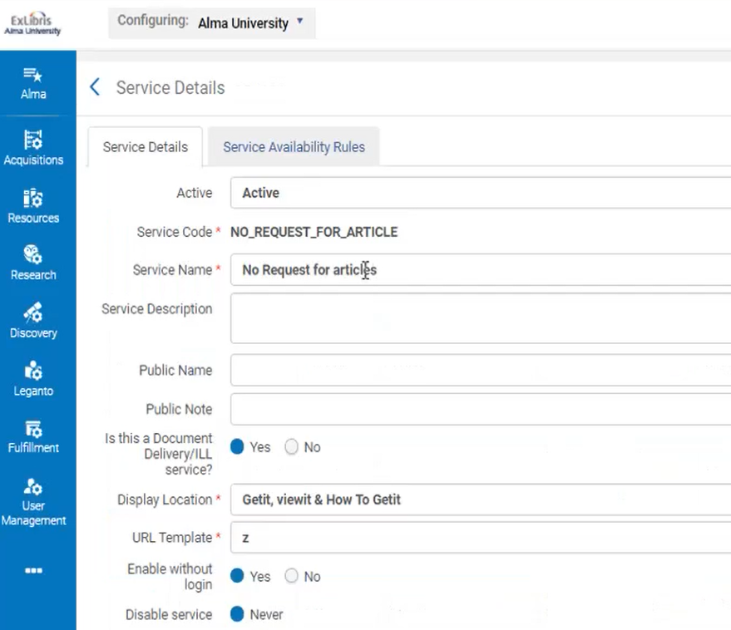
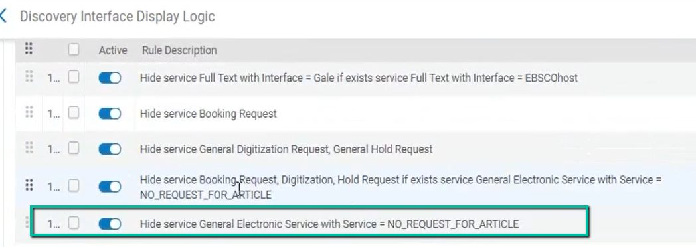
Configuration
The GES is actually a dummy, used to help identify that this is an article. We will remove it using the display logic rules AFTER we used it

Slide 20
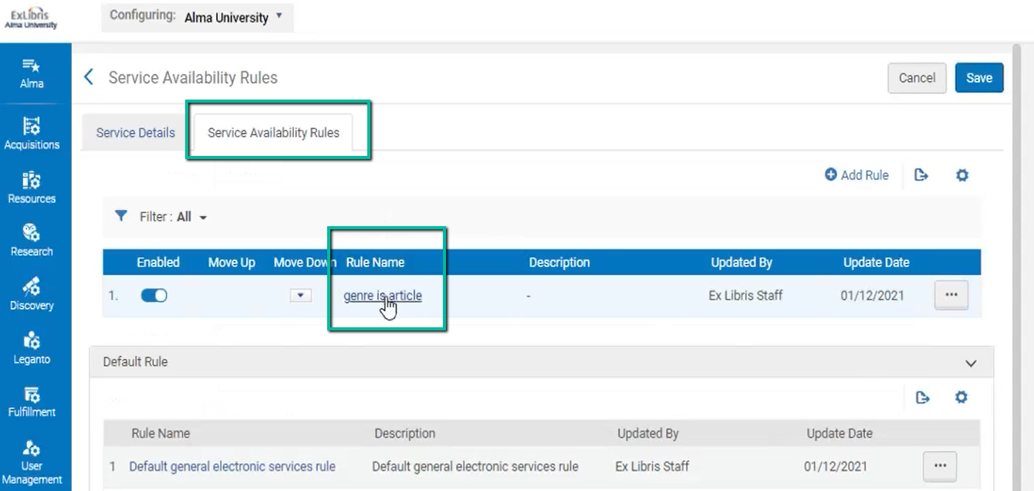
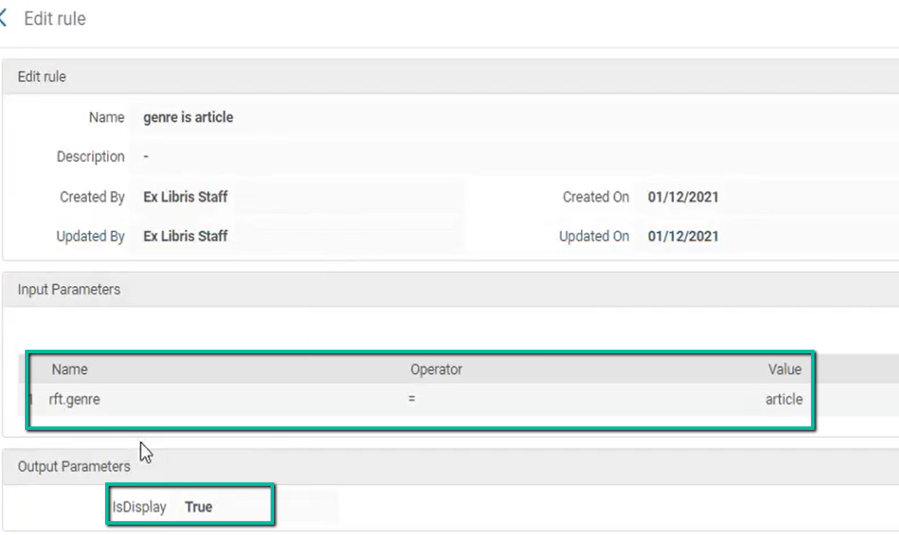
Configuration
This way we make sure the services exists only for articles

Slide 21
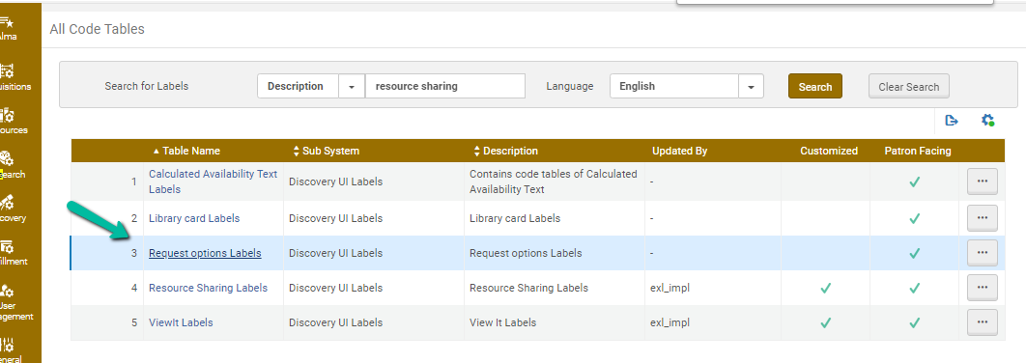
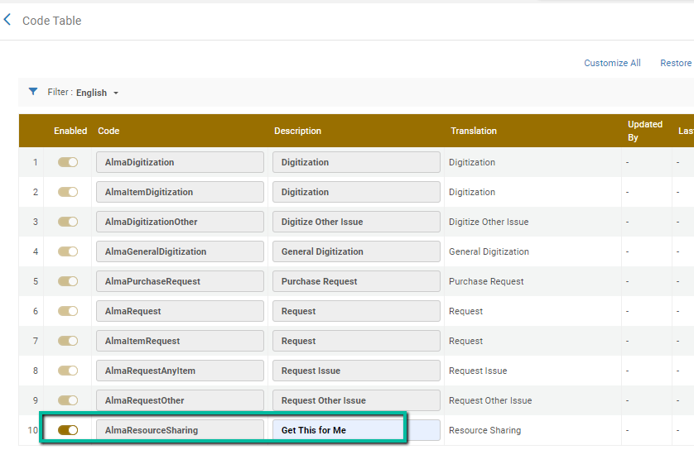
Configuration

Slide 22
Branch library processing of digital requests

Slide 23
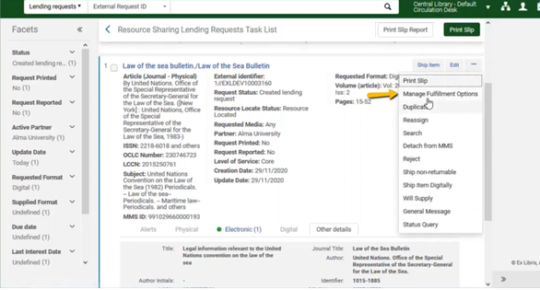
Branch library processing of digital requests (E items)
A new lending request that can be fulfilled by using an electronic item will normally be fulfilled by the resource sharing staff themselves

Slide 24
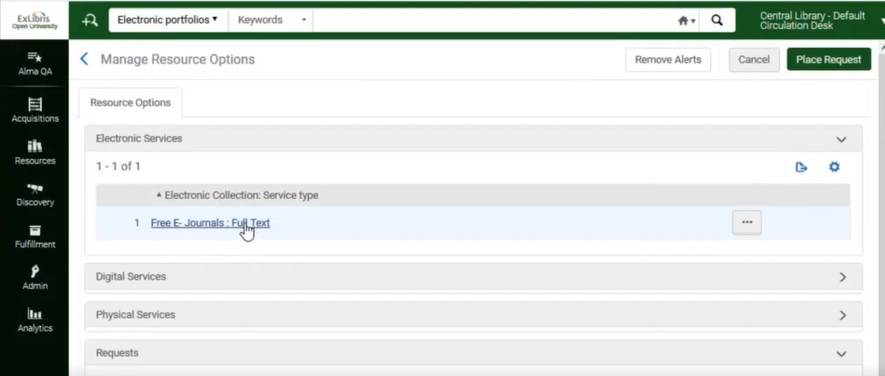
Branch library processing of digital requests (E items)
A new lending request that can be fulfilled by using an electronic item will normally be fulfilled by the resource sharing staff themselves

Slide 25
Branch library processing of digital requests (P item)
If the request can be fulfilled only by scanning a physical resource (article or book chapter) then the library may implement a number of policies:
Have the resource sharing staff digitize the required resource and send it
Request from a branch library to digitize the resource and upload it. Alma will automatically use the uploaded resource to fulfill the request.
Assigning the branch library can be done manually or automatically

Slide 26
Resource sharing staff digitize the required resource and send it

Slide 27
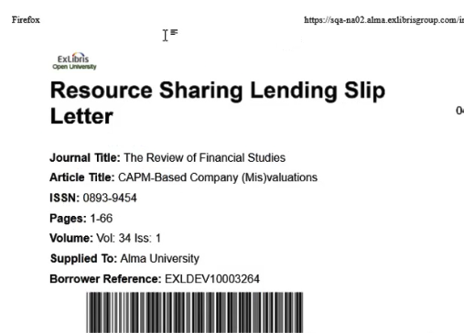
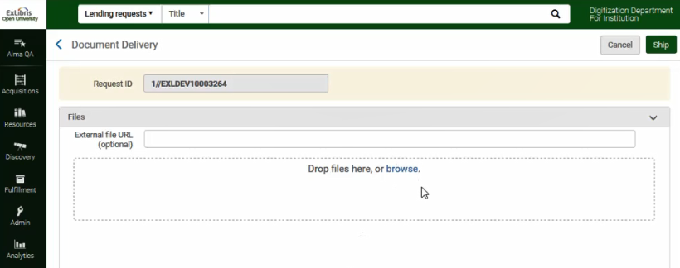
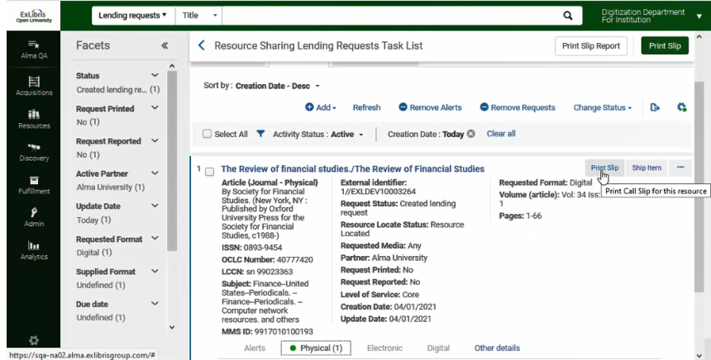
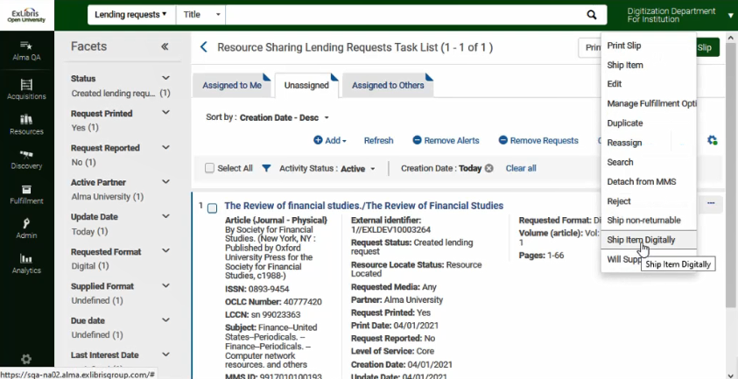
1. Resource sharing staff digitize the required resource and send it
The resource sharing staff will print the pick slip, get the item, and ship it

Slide 28
Branch library is assigned the task to digitize the required resource and send it

Slide 29
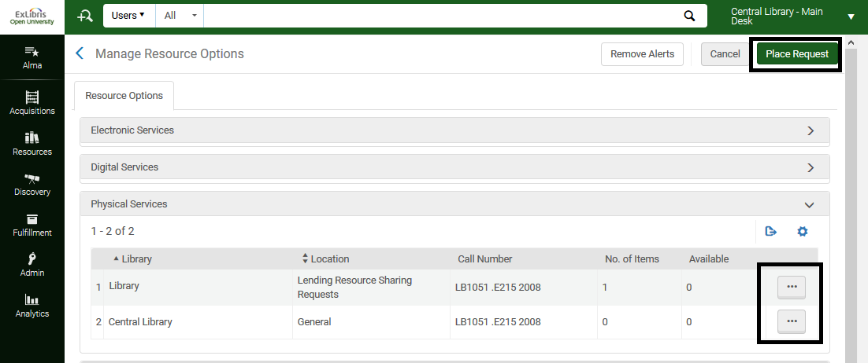
2. Branch library is assigned the task to digitize the required resource and send it
Manually – The library staff can use the Manage Fulfillment Options to manually assign the request to a branch library

Slide 30
2. Branch library is assigned the task to digitize the required resource and send it
Automatically - This is achieved by accessing the Fulfillment>Other Settings menu, and setting the rs_auto_request_lending parameter to true.
The lending request will be created with a status of ‘Being Processed’ and a ‘ship digitally’ request is already created.
The request is a title level request
Like all fulfillment title requests, one of the holdings is automatically assigned the task of fulfilling the request.

Slide 31
2. Branch library is assigned the task to digitize the required resource and send it
If the lender's resource is a multi volume or a serial then the library may implement a number of policies:
Not have Alma automatically create the 'Ship Digitally' request
This will enable the resource sharing staff to identify the requests that have not been automatically assigned to the branch library by faceting for requests with a status of 'created lending request'. The staff will then manually create a request on the requested issue or volume.
This workflow is suitable for libraries that manage a physical item in Alma for each of the issues/volumes. The resource sharing staff will identify the exact required copy and place a request on it.
This is achieved by setting the rs_auto_request_lending_with_serials and the rs_auto_request_lending_with_volume_issue parameters to false

Slide 32
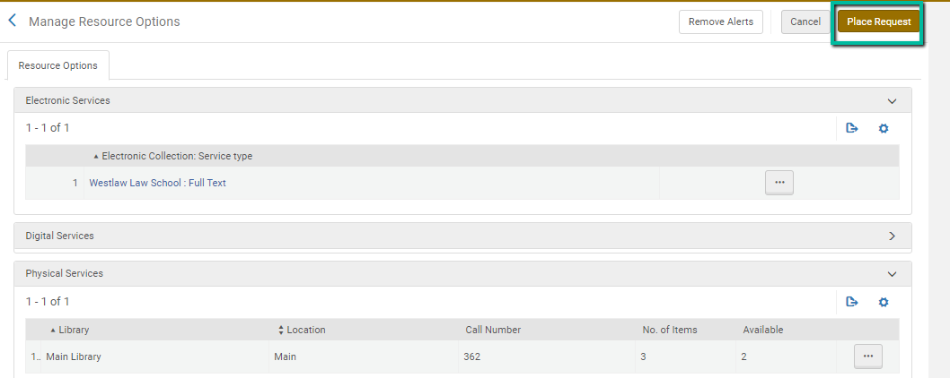
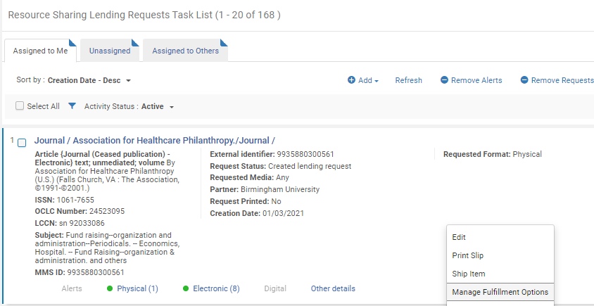
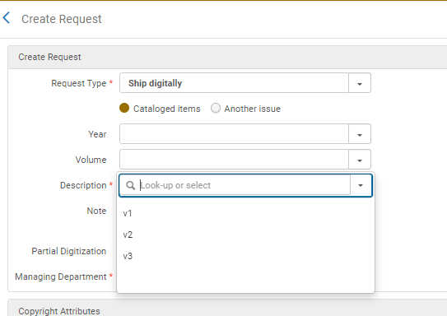
2. Branch library is assigned the task to digitize the required resource and send it

Slide 33
2. Branch library is assigned the task to digitize the required resource and send it
If the lender's resource us a multi volume or a serial then the library may implement a number of policies:
Have Alma automatically create the 'Ship Digitally' request as a title request.
This workflow is suitable for libraries that manage a single physical item in Alma for the entire serial/multi volume title. The single physical item represents all of the issues/volumes. The title level request will enable library staff at the branch to digitize the required article or chapter
This is achieved by setting the rs_auto_request_lending_with_serials and the rs_auto_request_lending_with_volume_issue parameters to true

Slide 34
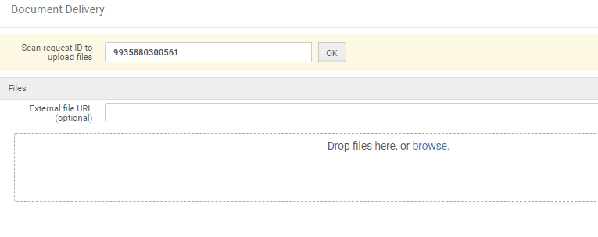
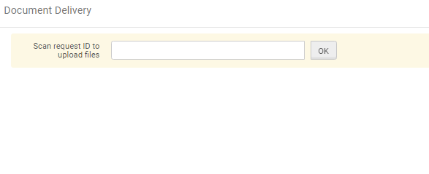
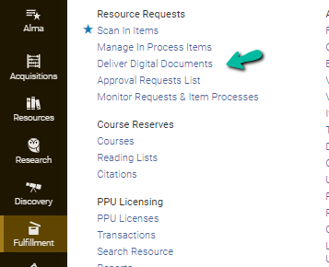
2. Branch library is assigned the task to digitize the required resource and send it
Since the physical issues are not barcoded, the issue is not processed via a Scan In process. It is digitized, and once done the ‘Deliver Digital Documents’ UI can be used to complete the request using the request ID (and not item barcode)

Slide 35
2. Branch library is assigned the task to digitize the required resource and send it
If the lender's resource us a multi volume or a serial then the library may implement a number of policies:
Have Alma automatically create the 'Ship Digitally' request as a general request.
This workflow is suitable for libraries that manage multiple physical items in Alma for the serial/multi volume title (like option 1 – manual handling). Using this option, an automated process for requesting from the branch library can be implemented, using Alma’s General Request workflow.
This is achieved by setting the rs_auto_request_lending_with_serials and the rs_auto_request_lending_with_volume_issue parameters to general

Slide 36
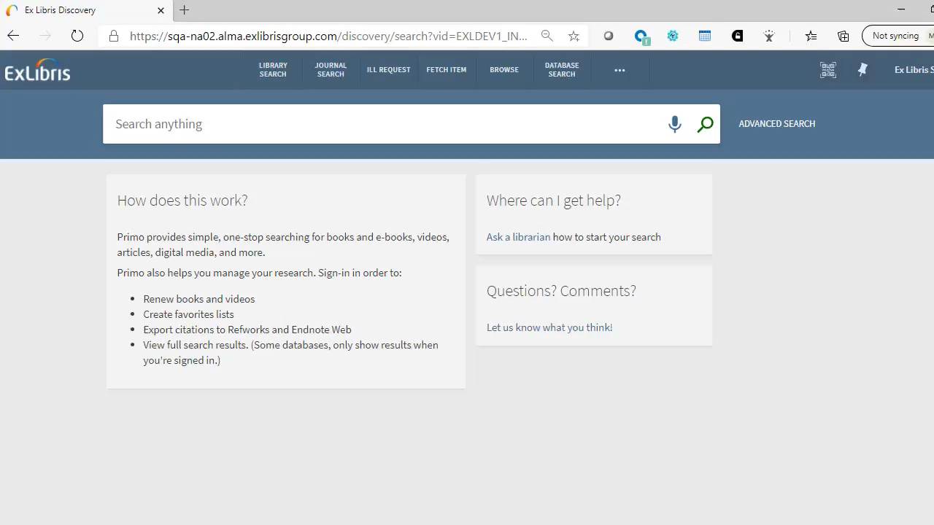
2. Branch library is assigned the task to digitize the required resource and send it
Have Alma automatically create the 'Ship Digitally' request as a general request

Slide 37
Digitization Requests Processed at the Circulation Desk
When a Ship Digitally request is automatically created at the lender side, it is assigned to the digitization department that has been defined by the rs_default_digitization_department parameter. Setting this parameter is mandatory for automatic creation of Ship Digitally requests
For example, setting this parameter to DIGI_DEPT_INST will have all automatically created Ship Digitally requests be assigned to the OTB digitization department

Slide 38
Digitization Requests Processed at the Circulation Desk
Setting the rs_default_digitization_department parameter to prefer_local will have the affect of assigning the request to a local digitization department if one exists.
For example;
If the item that is to be digitized belongs to the Central Library, and a desk at the Central Library supports digitization then the request will be assigned to that desk.
If there is no digitization department at the library that owns the item then an institution level digitization department will be selected.

Slide 39
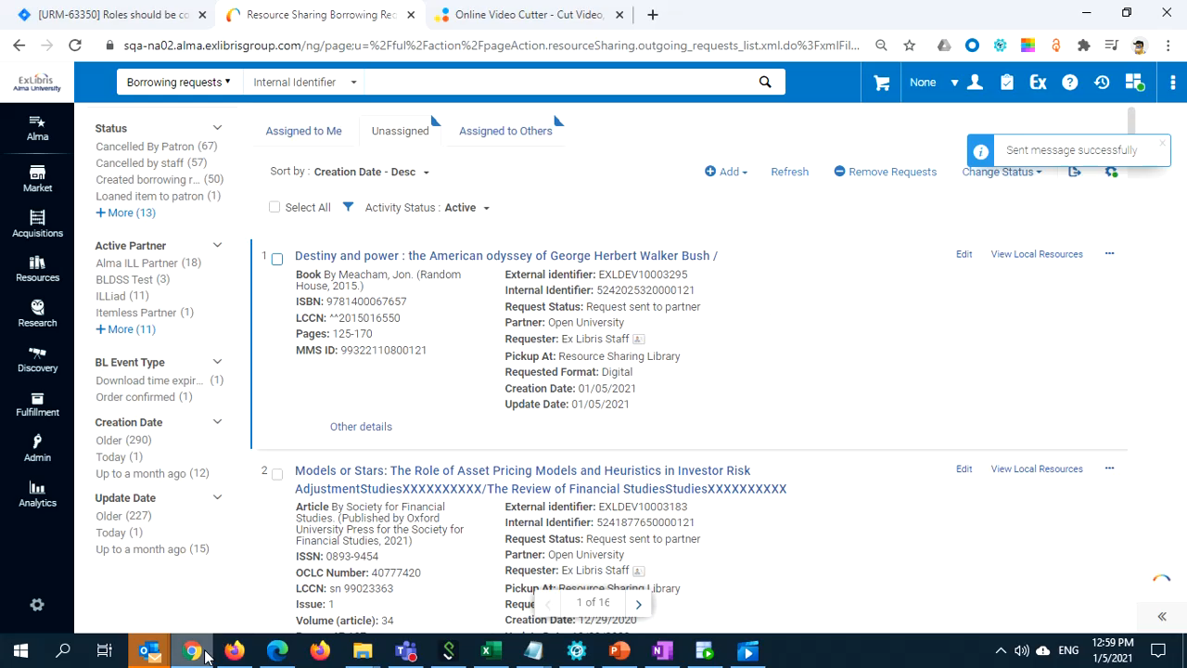
Digitization Requests Processed at the Circulation Desk

Slide 40
Moshe.shechter@exlibrisgroup.com

